Slide 1

State Prohousing Designation County of Ventura
Informational Overview & Project Roadmap
LUNCH AND LEARN
February 17, 2026
Notes:
Dave or Kimberlee

Slide 2
Why are you here?
Provide overview on upcoming Prohousing Designation application for unincorporated County
Gather input from important stakeholders for this new state effort
Share amongst your network for a successful public outreach in May
Notes:
Dave

Slide 3
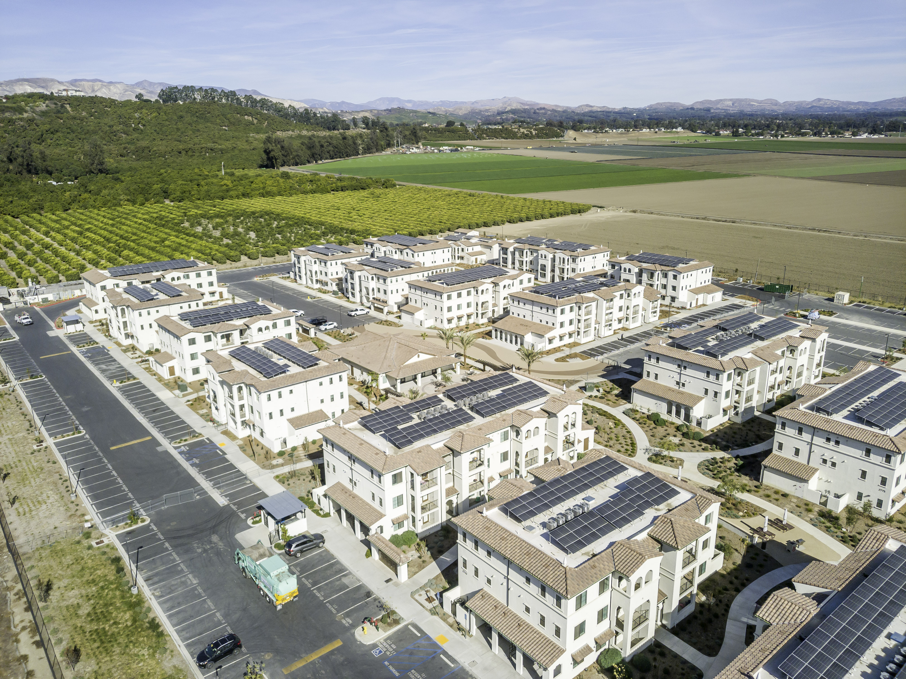

What is the Prohousing Designation?
State program that recognizes jurisdictions that go above and beyond minimum housing laws
Administered by CA Department of Housing & Community Development (HCD)
Goal: Accelerate housing production and remove barriers
Align local policy to maximize housing opportunities
Somis Ranch
Finch Ranch
Notes:
Tracy

Slide 4
Program Background
Developed in response to California’s ongoing housing production shortfall
Recognizes that local land use and process reforms are critical to housing delivery
Shifts state focus from regulatory compliance to housing outcomes
Establishes incentives for jurisdictions willing to implement meaningful reforms
Notes:
Tracy

Slide 5
Benefits of Prohousing Designation
Exclusive access to the Prohousing Incentive Program (PIP) grant
Priority scoring for State housing and infrastructure programs (e.g., Affordable Housing and Sustainable Communities (AHSC), Infill Infrastructure Grant (IIG), Sustainable Transportation Planning grant program)
Recent communications from the Governor have indicated that receipt of Homeless Housing and Assistance and Prevention Funds (HHAP) (Round 7) will require that the County achieved a Prohousing Designation.
Demonstrates County leadership and commitment to RHNA progress
Notes:
Tracy

Slide 6
Application Process
Staff develops Draft application, with technical guidance from HCD
1
Board of Supervisors Public Hearing
(April 28, 2026)
2
30-day Diligent Public Participation
(May 2026)
3
Public comment review period + Application edits
(May-June 2026)
4
Formal State submission
(Anticipated June 2026)
5
Award of Prohousing Designation
(Anticipated Summer 2026)
6
Notes:
Joy

Slide 7
Application Structure
Must meet Threshold requirements:
Compliant Housing Element
Annual Progress Report
Seven (7) Appendices (required)
Appendix 1: Formal Resolution
Appendix 2: Proposed Policies
Appendix 3: Self-Scoring Sheet
Appendix 4: Enhancement Factor Examples
Appendix 5: Homeless Encampment Policy
Appendix 6: Public Participation Process
Appendix 7: Additional Information and Supporting Documentation
Points awarded on Base criteria and Enhancement Factors
Minimum of 30 points required
Higher Score increases Grant competitiveness
Notes:
Joy

Slide 8
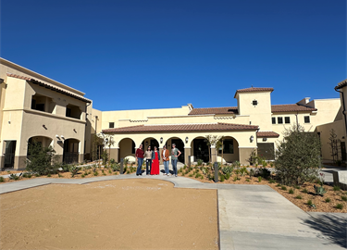
Appendix 3: Category 1, Favorable Zoning and Land Use
1. Favorable Zoning and Land Use
Exceeds state ADU requirements – County allows larger + attached ADUs, in all zones with residential uses, and increases capacity on SF lots beyond state ADU law.
Projects with eliminated or reduced parking requirements under state law, (ADU, density bonus, supportive housing) – allows greater flexibility for development.
Potential Inclusionary housing requirements – through updated regulations for Residential High Density (RHD) zoned parcels (20 du/ac, approved ministerially); ongoing Program HE-K will evaluate feasibility of inclusionary housing policies consistent with AB 1505. (Proposed)
Policies that expand housing capacity and flexibility by allowing more housing types, densities, or residential uses through zoning and land use regulations
Rancho Sierra Senior Apartments
Notes:
Joy

Slide 9
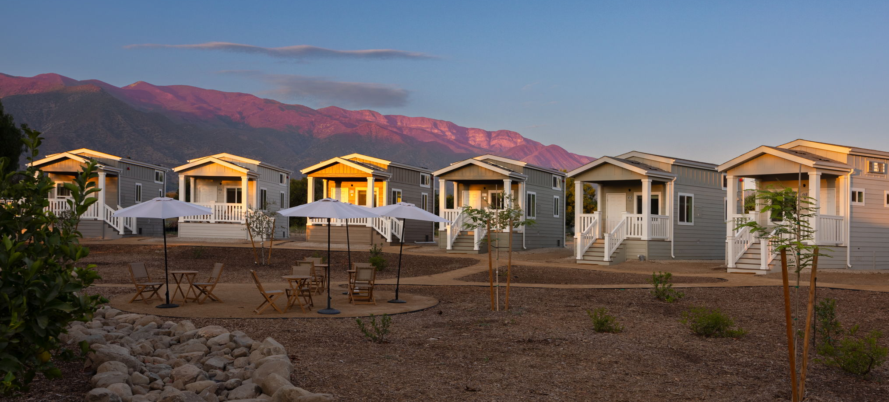
Appendix 3: Category 2, Acceleration of Housing Production Timelines
2. Acceleration of Housing Production Timeframes
Ministerial approval for multiple housing types – Single-family, two-family, and certain multifamily housing may be approved with Zoning Clearance, reducing review time, accelerating housing production.
Projects approved using streamlined ministerial applications/review processes – Examples such as Camino de Salud Supportive Housing (49 units), Rancho Sierra Senior Apartments (50 units), Highland Drive (12 units).
Projects approved without public hearings – In the 6th cycle HE period, 537 units were approved without a public hearing, accelerating housing production.
Actions that shorten permitting review and approval timelines to speed up housing production
Mesa Farm Tiny Homes
Notes:
Joy

Slide 10
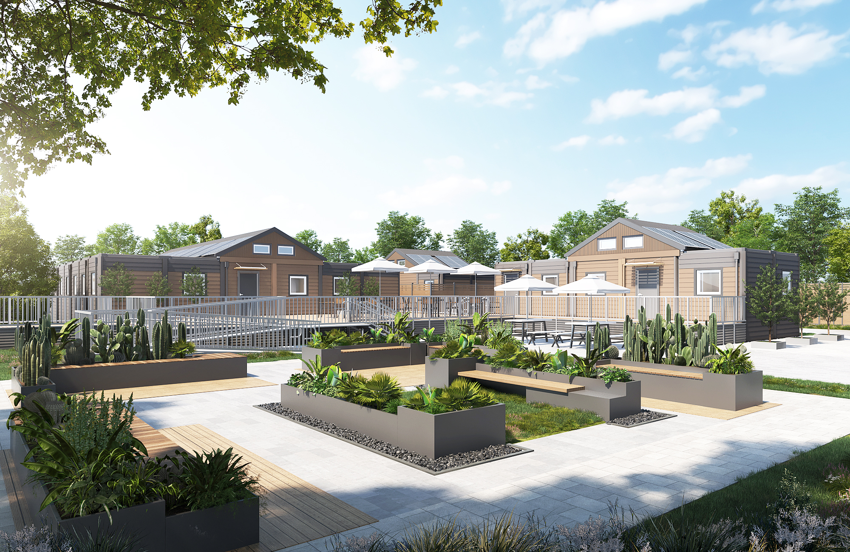
Appendix 3: Category 3, Reduction of Construction & Development Costs
3. Reduction of Construction and Development Costs
Pre-application fee waivers – Concept Project Review fee waived for 100% affordable housing projects.
Reduced regulatory barriers for lower-income housing – Updated RHD regulations allows ministerial approval and expanded alternative compliance options to facilitate housing affordable to lower-income households.
Innovative housing options – Ministerial approval of self-contained agricultural worker trailers provides a lower-cost housing option; additional housing types being explored through Program LU-C. (Proposed)
Fee waivers, streamlined processes, and cost-saving measures that lower financial barriers to housing production
Homekey+ Lewis Road Supportive Housing Project
Notes:
Joy

Slide 11
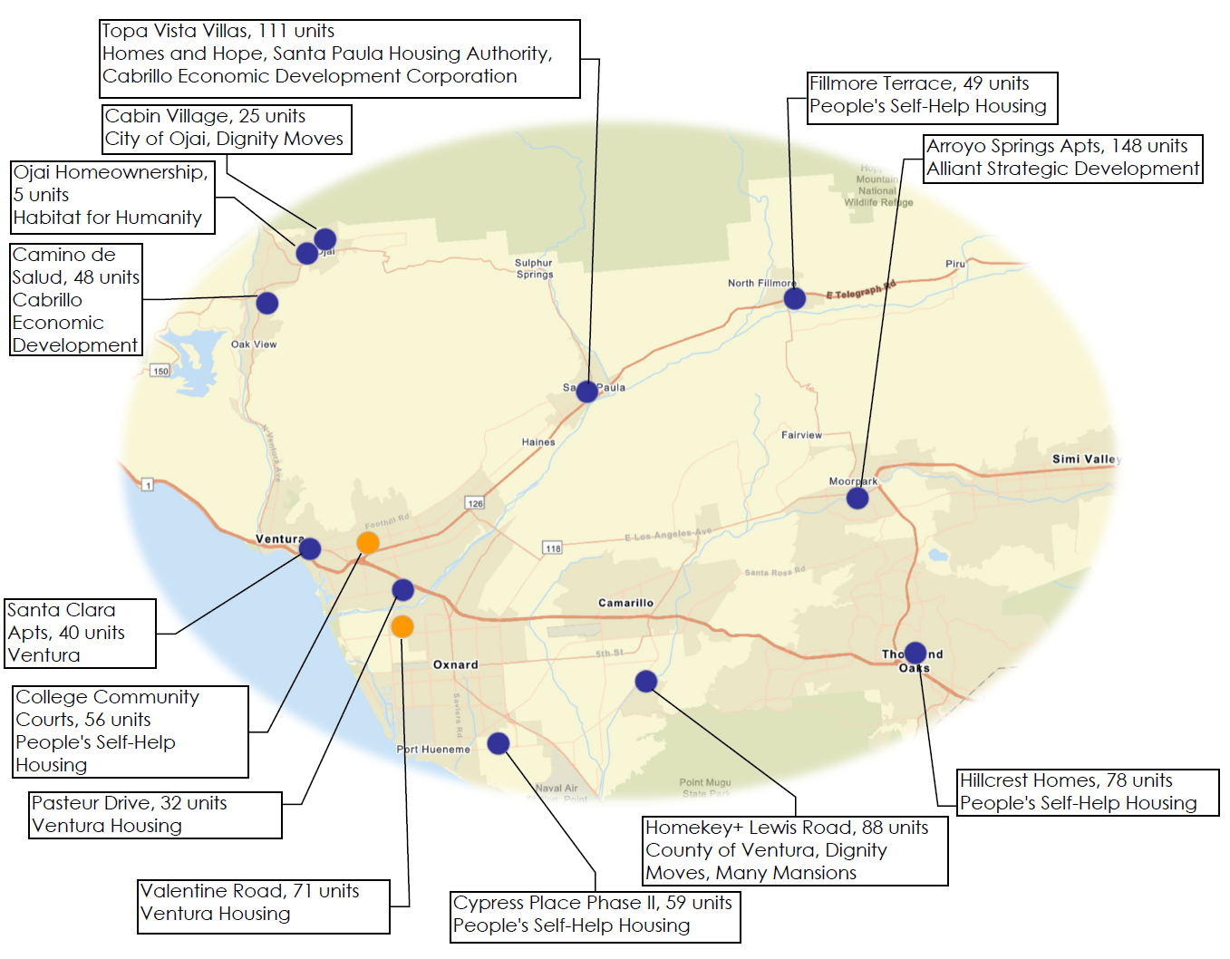
Appendix 3: Category 4, Financial Subsidies
Regular investments of federal, state, and local funding, including a one-time investment of more than $30M in general funds, to preserve and create new affordable housing and address homelessness
Significant financial investments into the Housing Trust Fund Ventura County’s revolving loan fund
Use of County owned, surplus land for affordable housing development
Support of other local public agencies in evaluating their underutilized infill land for housing
Providing operational subsidies for Permanent Supportive Housing and Interim Housing for persons experiencing homelessness.
County investments are supporting 810 new units of affordable
rental and for-sale housing for lower-income households!
Notes:
Tracy

Slide 12
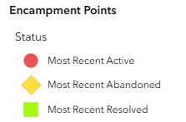
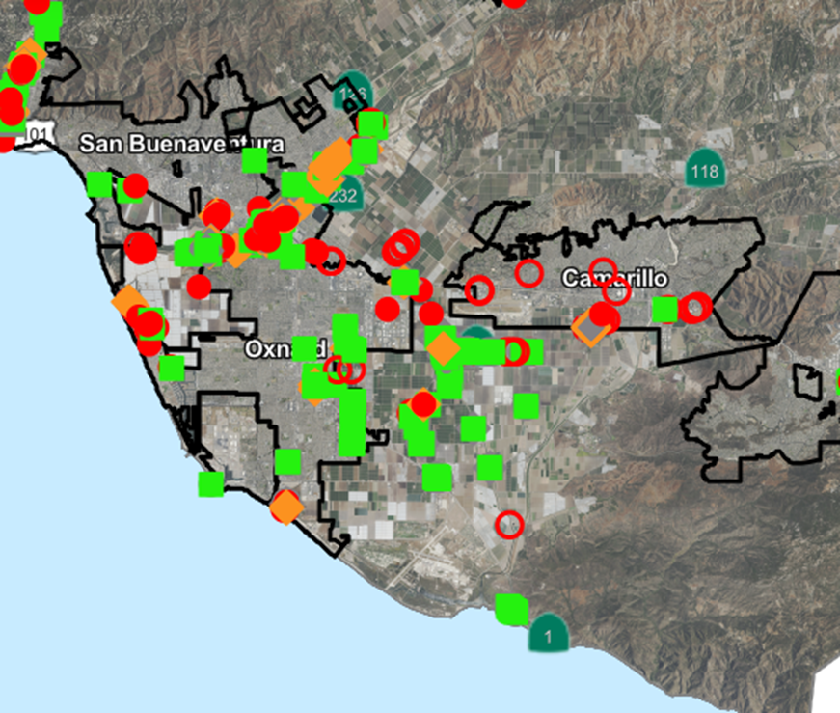
Appendix 5: Homeless Encampment Policy
Board of Supervisors have approved two ordinances aligned with State guidance to resolve encampments emphasizing housing, shelter and services for persons living in the encampments.
Board of Supervisors funded Homeless Liaison Unit as part of Ventura County Sheriffs Office to provide outreach and increase public safety.
Encampment survey mobile application launched including GIS mapping identified 669 encampment location sites with 567 persons in 2025.
339 encampments have been resolved; 209 active encampments remained at the end of the year.
Notes:
Kimberlee

Slide 13
Appendix 6: Public Outreach
Board of Supervisors Hearing (anticipated April 28, 2026;10:30am)
Legal Notice
Signed Resolution
Diligent Public Outreach (30-day period, May 2026)
Prohousing Designation webpage
Planning Commission input
Continuum of Care virtual meeting (May 21, 2026; 10:30am-12pm)
Public webinar
Flyers, social media posts, listserv outreach
Written comment
Notes:
Joy

Slide 14
Questions and Feedback

Slide 15
Thank You!
PROJECT CONTACTS
JOY WERNER, ASSISTANT PLANNER
Resource Management Agency, Planning Division
Email: Joy.Werner@venturacounty.gov
Phone: (805) 477 - 7164
TRACY MCAULAY, HOUSING SOLUTIONS DIRECTOR
County Executive Office
Email: Tracy.McAulay@venturacounty.gov
Phone: (805) 232 - 1371

